Slide 1
Indian Institute of Information Technology, Dharwad
Course: Database Management System
Course Code: CS502
TOPIC: SQL QUERY OPTIMISATION , IMPORTANCE, TECHNIQUES AND TOOLS
Under the Supervision of:
Dr. UMA SESHADRI Ma’am
Presented By: AKSHAY JAIN
Registration Number: 17BCS002

Slide 2
CONTENT
INTRODUCTION
RESPONSIBILITY OF QUERY OPTIMISER
QUERY OPTIMISER AS A SEARCH PROBLEM
DESIRABLE OPTIMISER
GENERAL TIPS FOR QUERY OPTIMISATION
TOOLS AVAILABLE
REFERENCES

Slide 3
INTRODUCTION
SQL Queries can be used to retrieve data from any database.
Optimisation basically is seen in the context of time.
An important skill for application developer and data administrator.
Query tuning involves knowledge of techniques such as cost-based and heuristic-based optimisers, plus the tools an SQL Platform provides for explaining a query execution plan.

Slide 4
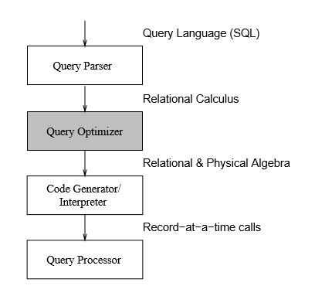
INTRODUCTION
QUERY PATH IN A DBMS

Slide 5
INTRODUCTION
The path that a query traverses through a DBMS:
THE QUERY PARSER checks the validity of the query and then translates it into an internal form, usually a relational calculus expression or something equivalent.
THE QUERY OPTIMISER examines all algebraic expressions that are equivalent to the given query and chooses the one that is estimated to be the cheapest.
The CODE GENERATOR or the Interpreter transforms the access plan generated by the optimizer into calls to the query processor.
The QUERY PROCESSOR actually executes the query.

Slide 6
RESPONSIBILTY OF QUERY OPTIMISER
The query optimizer is responsible for generating the input for the execution engine. It takes a parsed representation of a SQL query as input and is responsible for generating an efficient execution plan for the given SQL query from the space of possible execution plans.
Notes:
The query execution engine implements a set of physical operators, An operator takes as input one or more data streams and produces an output data stream.

Slide 7
QUERY OPTIMISER as a SEARCH PROBLEM
Query optimiser can be viewed as a difficult search problem. In order to solve this problem, we need to provide:
A space of plans(Search Space)
A cost estimation technique
An enumeration algorithm

Slide 8
DESIRABLE OPTIMISER
The search space includes plans that have low cost.
The costing technique is accurate.
The enumeration algorithm is efficient.

Slide 9
GENERAL TIPS FOR QUERY OPTIMISATION
TABLE Schemas:
sales {prod_id, cust_id, quantity_sold, time_id}
customers {cust_id, cust_marital_status, country_id}
products {prod_id, prod_min_price, prod_list_price}
countries {country_id, country_name}
costs {prod_id, unit_price}

Slide 10
GENERAL TIPS FOR QUERY OPTIMISATION
TIP 1: Use of column name instead of * in a SELECT statement
e.g. Original Query:
SELECT * FROM sales;
e.g. Optimised Query:
SELECT prod_id FROM sales;

Slide 11
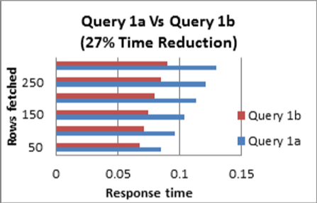

Slide 12
GENERAL TIPS FOR QUERY OPTIMISATION
TIP 2: Avoid including a HAVING clause in SELECT statement
e.g. Original Query:
SELECT cust_id, count(cust_id)
FROM sales GROUP BY cust_id
HAVING cust_id != ‘1660’ AND cust_id != ‘2’;
e.g. Optimised Query:
SELECT cust_id, count(cust_id)
FROM sales
WHERE cust_id != ‘1660’ AND cust_id != ‘2’
GROUP BY cust_id;

Slide 13
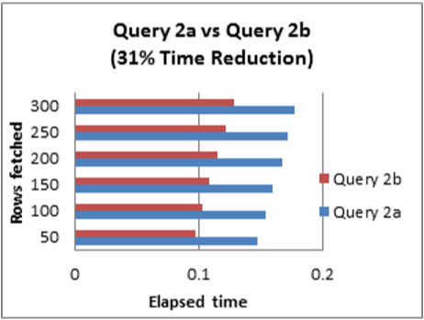

Slide 14
GENERAL TIPS FOR QUERY OPTIMISATION
TIP 3: Eliminate unnecessary DISTINCT condition
e.g. Original Query:
SELECT DISTINCT * FROM sales JOIN customers ON sales.cust_id = customers.cust_id
WHERE customers.cust_marital_status = ‘single’;
e.g. Optimised Query:
SELECT * FROM sales JOIN customers ON
sales.cust_id = customers.cust_id
WHERE customers.cust_marital_status=‘single’

Slide 15
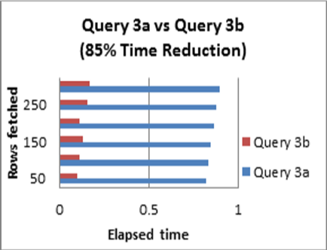

Slide 16
GENERAL TIPS FOR QUERY OPTIMISATION
TIP 4: Un-nest Sub-Queries
e.g. Original Query:
SELECT * FROM products WHERE products.prod_id = (
SELECT prod_id FROM sales
WHERE cust_id = 109 AND quantity_sold = 1);
e.g. Optimised Query:
SELECT * FROM products, sales
WHERE products.prod_id = sales.prod_id
AND cust_id = 109 AND quantity_sold = 1;

Slide 17
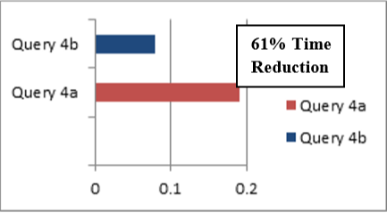
ROWS FETCHED
ELAPSED TIME

Slide 18
GENERAL TIPS FOR QUERY OPTIMISATION
TIP 5: Consider using an IN predicate when querying an indexed column
e.g. Original Query:
SELECT * FROM sales WHERE prod_id = 14 OR prod_id = 17;
e.g. Optimised Query:
SELECT * FROM sales WHERE prod_id IN (14, 17);

Slide 19
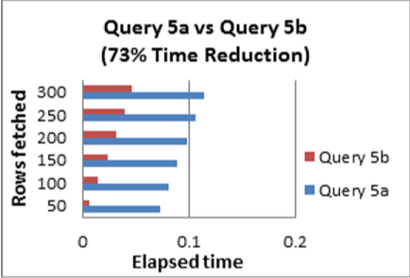

Slide 20
GENERAL TIPS FOR QUERY OPTIMISATION
TIP 6: Use EXISTS instead of DISTINCT when using table joins that involves tables having one-to-many relationships
e.g. Original Query:
SELECT DISTINCT country_id, country_name
FROM countries ,customers
WHERE customers.country_id = countries.country_id;
e.g. Optimised Query:
SELECT country_id, country_name FROM countries
WHERE EXISTS (
SELECT 'X' FROM customers
WHERE customers.country_id = countries.country_id);

Slide 21
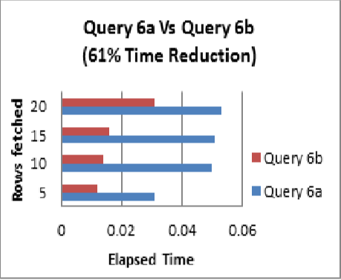

Slide 22
GENERAL TIPS FOR QUERY OPTIMISATION
TIP 7: Try to use UNION ALL in place of UNION
e.g. Original Query:
SELECT cust_id FROM sales UNION
SELECT cust_id FROM customers;
e.g. Optimised Query:
SELECT cust_id FROM sales UNION ALL
SELECT cust_id FROM customers;

Slide 23
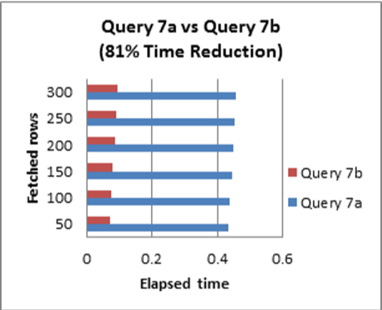

Slide 24
GENERAL TIPS FOR QUERY OPTIMISATION
TIP 8: Avoid using OR in join conditions
e.g. Original Query:
SELECT * FROM costs INNER JOIN products ON unit_price = prod_min_price OR unit_price = prod_list_price;
e.g. Optimised Query:
SELECT * FROM costs INNER JOIN products ON unit_price = prod_min_price UNION ALL
SELECT * FROM costs INNER JOIN products ON unit_price = prod_list_price;

Slide 25
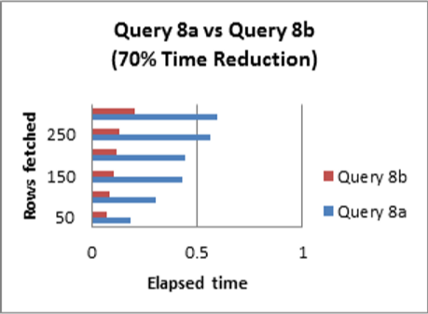

Slide 26
GENERAL TIPS FOR QUERY OPTIMISATION
TIP 9: Avoid functions on the right hand side of the operator
e.g. Original Query:
SELECT * FROM sales WHERE EXTRACT (
YEAR FROM TO_DATE (time_id, ‘DDMON-RR’)) = 2001
AND EXTRACT (MONTH FROM TO_DATE (time_id,
‘DD-MON-RR’)) =12;
e.g. Optimised Query:
SELECT * FROM sales WHERE TRUNC (time_id)
BETWEEN TRUNC(TO_DATE(‘12/01/2001’, ’mm/dd/yyyy’))
AND TRUNC (TO_DATE (‘12/30/2001’,’mm/dd/yyyy’));

Slide 27
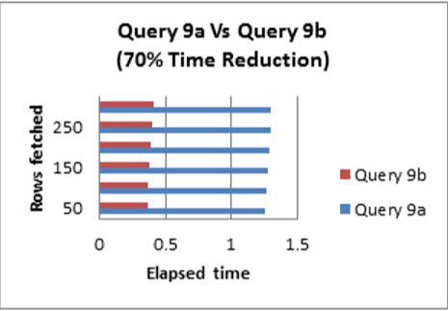

Slide 28
GENERAL TIPS FOR QUERY OPTIMISATION
TIP 10: Remove any redundant mathematics
e.g. Original Query:
SELECT * FROM sales
WHERE cust_id + 10000 < 35000;
e.g. Optimised Query:
SELECT * FROM sales
WHERE cust_id < 25000;

Slide 29
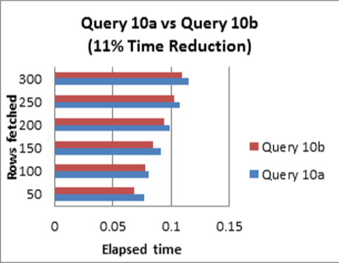

Slide 30
TOOLS AVAILABLE
SolarWinds Database Performance Analyser
SQL Server Management Studio(Microsoft SQL Sever)
EverSQL (online tool)

Slide 31
REFERENCES
An overview of Query optimization in Relational Systems (Research Paper by Surajit Chaudhuri)
Query optimization techniques – Tips for writing efficient and faster SQL Queries (Research Paper by Jean HABIMANA)
Query Optimization (Research Paper by Yannis E. Ionnidis)

Slide 32
THANK YOU

